Slide 1




Common Linux Process Utilities
Welcome to this guide on the most widely-used process utilities in the Linux operating system. Processes are essential components of the system, and managing them correctly can help improve the stability and security of your machine. In this presentation, you'll learn the syntax, examples, and purposes behind various process utilities, including ps, top, kill, pkill, pgrep, htop, pstree, killall, and nice/renice.
by Shravani Potharaju

Slide 2

ps - Process Status
The ps command is used to probe the process status on a Linux system. It provides information on the active running processes currently running on your machine. By using various options, you can get different slice views of the running processes. Usage and options are simple yet powerful.
Syntax
Example
Purpose
ps [options]
ps aux
Displays information about running process.

Slide 3
top - System Monitoring
The top command is a Linux utility for real-time system and process monitoring. By default, it provides an ordered view of the active system processes sorted by the amount of CPU usage. You can use hotkeys to adjust what information is displayed on your screen dynamically. The tool is very interactive and efficient.
1
Syntax
top
Example
2

Slide 4
kill - Terminate Processes
Kill command is a basic yet powerful tool for terminating processes in a Linux environment. When a process becomes unresponsive, you can use this command to forcibly stop the process by sending a signal to it. Make sure you properly understand the signal values and the process ID that you need to end.
1
Syntax
kill [signal] PID
Example
2

Slide 5
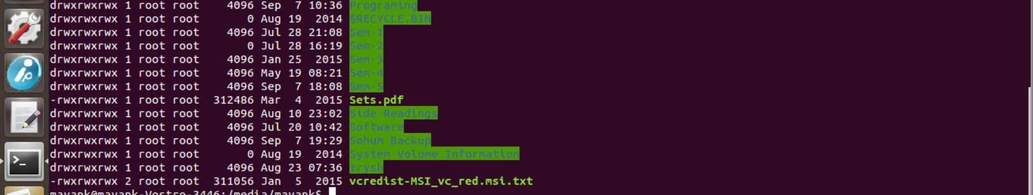
pkill - Kill by Process Name
If you don't know the exact process ID of the running process, you can use the pkill command to terminate it by its name. The utility is similar in functionality to the kill command but a bit more convenient. It can be used for multiple processes termination at once.
1
Syntax
2
Example
3
Purpose
pkill [options] process_name
pkill firefox
Terminates processes by their name.

Slide 6
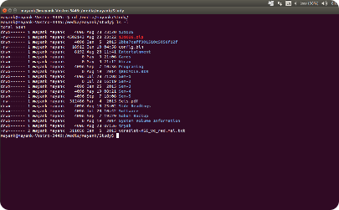
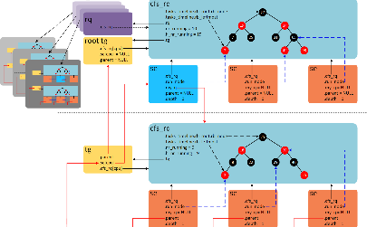
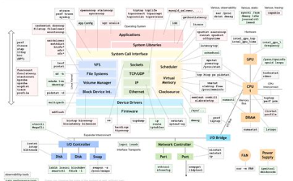
pgrep - Process Search
The pgrep command acts as a small tool for filtering out the processes that match the given process name or other defined criteria. If you want to find out the process ID based on its name, this tool is an excellent utility to use. It comes with various options to search and filter processes based on different criteria.
Syntax
Example
Purpose
pgrep [options] process_name
pgrep chrome
Searches for processes by name.

Slide 7
htop - Interactive Process Viewer
htop is an interactive and convenient process viewer that provides real-time visualizations of the running processes. It is a better alternative to the standard top command. htop acquires information by reading the proc filesystem and displays a tree-like layout that makes it quite simple to comprehend and use.
Syntax
Example
Purpose
htop
htop
Screen-based real-time process viewer.

Slide 8
Find Process by Name
The combination of ps and grep commands can be used to find running processes based on their name. The usage is quite simple, and it is useful when you know only the name of the process, and you want to find out more information about it or end it. The command also allows using several useful options to filter out relevant processes.
1
Syntax
ps aux | grep process_name
Example
2
ps aux | grep python
3
Purpose
Combines ps and grep commands to find processes by name.

Slide 9
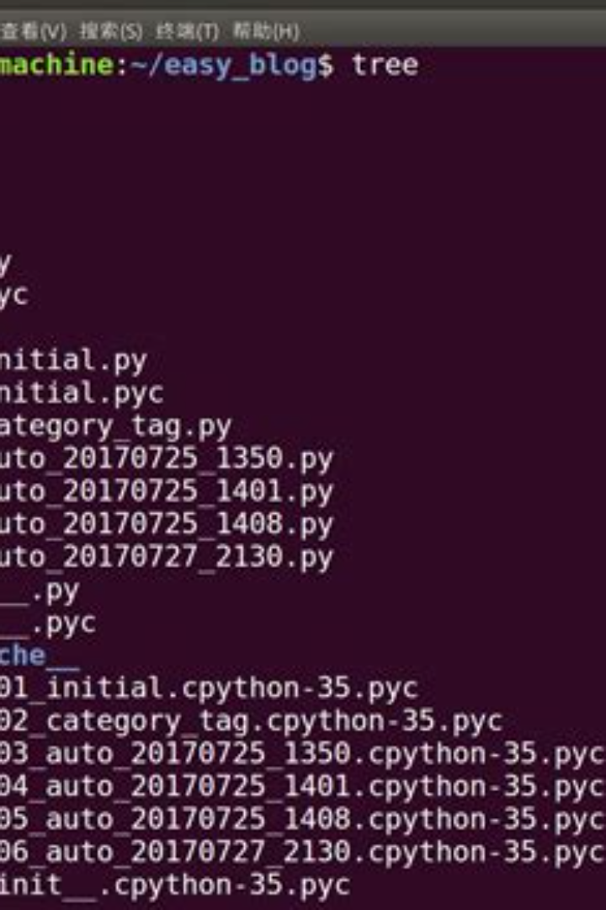
pstree - Process Tree
The pstree command represents a hierarchical and tree-like view of active processes running in your OS. Its uses epoll for fast and efficient data transition between processes. It comes with various options that allow you to define the width and depth of displayed nodes and other outlook options.
1
Syntax
2
Example
pstree [options]
pstree
3
Purpose
Displays running processes in a tree-like structure.

Slide 10
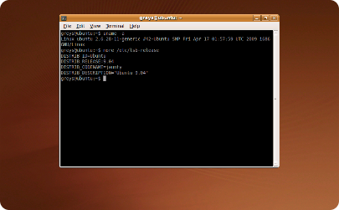
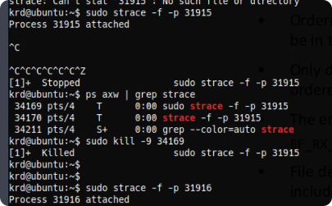
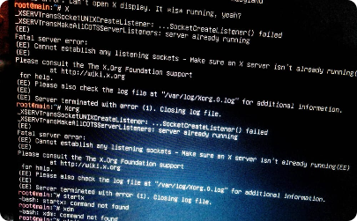
killall - Kill by Name
killall is another Linux utility that allows you to terminate processes by name, similar to the pkill and kill commands. It can terminate all instances of related processes and also sends signals to processes using their name. The command has different options to filter out processes based on various search criteria.
Syntax
Example
Purpose
killall [options] process_name
killall -9 firefox
Signaling and terminating processes by their name.

Slide 11
nice and renice - Adjust Process Priority
nice and renice are two Linux utilities that allow you to adjust process priority. They help to control the amount of CPU time given to a process. Whenever several processes are running at the same time on your machine, the operating system schedules process priorities based on their weights. Niceness is a way to control that.
Syntax for nice
Example for nice
Syntax for renice
nice -n increment command
nice -n 10 myprogram
renice [options] priority [-p] process_ID
Example for renice
Purpose
renice -n 10 -p 1234
Adjust the priority of processes.

Slide 12



Conclusion
In conclusion, process management is an essential skill that every Linux administrator should master. By harnessing the power of the Linux process utilities described in this guide, you can control and monitor system processes more efficiently. Make sure to use them wisely and leverage their power to streamline system configuration.

Slide 13
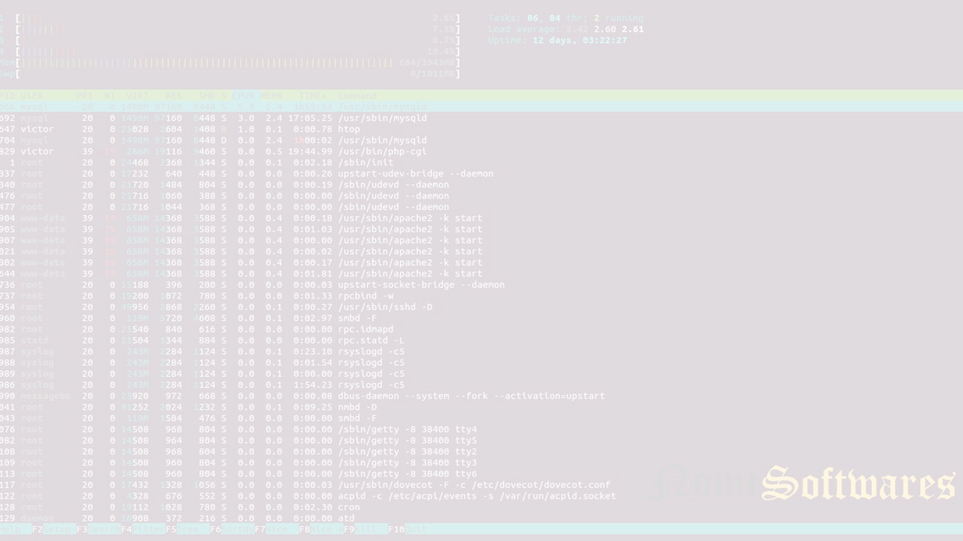
Thank You
Thank you for your time. I hope this presentation provided value and actionable ideas. If you have further questions or inquiries, please don't hesitate to contact me or the support team.

